Slide 1
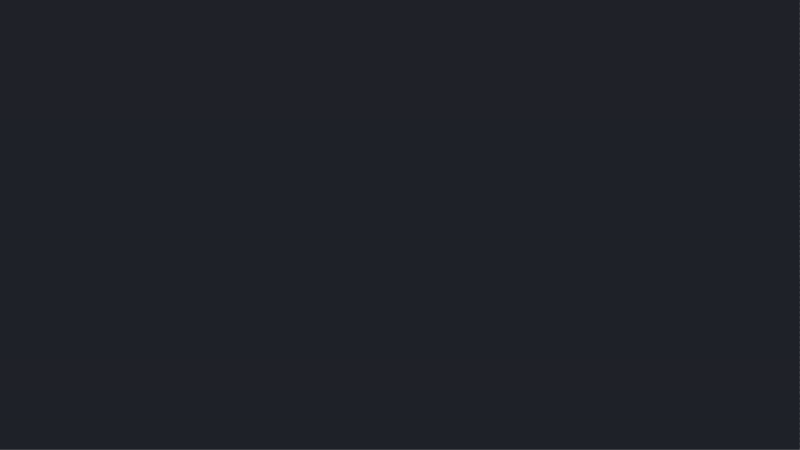


Stock prediction using Recurrent neural network
Report Proposed by :-
Ahmed Tamer-157978-CS
Ahmed Abohegazy -158324-SE
Ahmed ElHelw-158779-SE

Slide 2
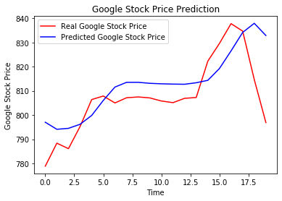
Why forecasting ?
-The idea is to forecast the stock prices at a given time step, it is important for investment to be able to predict the future situation of the stock market.
-As robust prediction system for stock markets can help investors and traders to be able take best decision in their investments, or even the owners of the companies to be to predict what might go wrong in the future which will lead to reduction in their stock price.

Slide 3
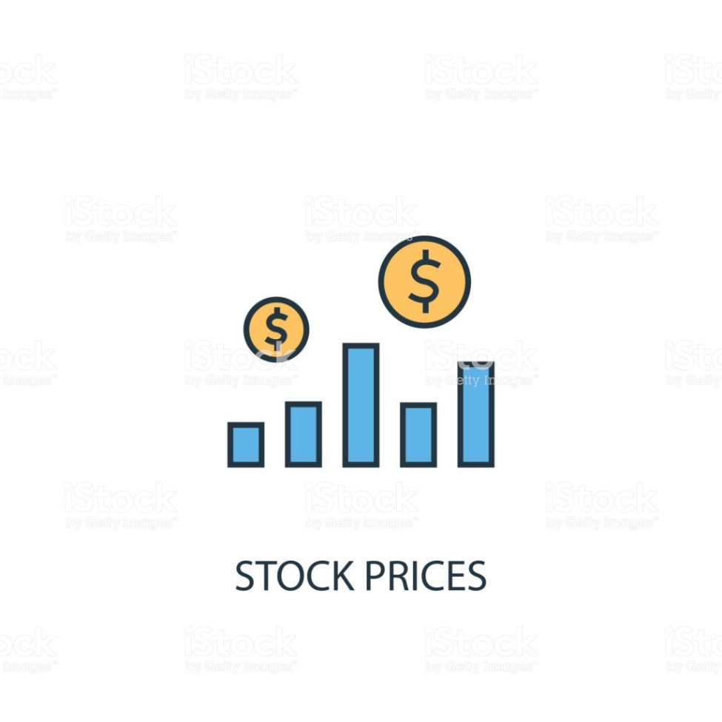
Data quality and pre-processing :
The dataset was collected from Kaggle
The data set congaing records about google stocks prices .
pre-processing is structuring the data with different time steps which the LSTM will memorize, the selected timesteps are 30,60 & 100.

Slide 4
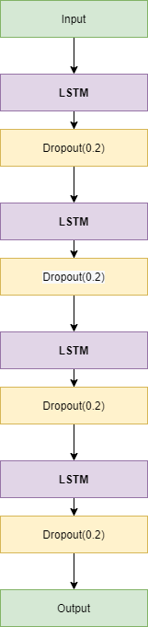
Architecture

Slide 5
Statistics
The performance for the 60 timesteps and 4 LSTM layers and dropouts was the best performing among the other trials, it’s curve is more smooth than the actual price which is expected, also it doesn’t go along as it actually works by seeing the trends, there is actual events that can affect the price that model won’t be able to detect unless the model is more advanced and able to scrap and read the news related to each company and predict how the such a news might affect the stock price performance.

Slide 6
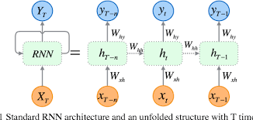

Applied architectures
Recurrent neural network
Long-short term Memory

Slide 7
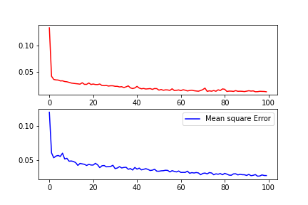
Learning evaluation

Slide 8
Possible model improvement methodologies
The possible improvements are using different batch sizes and epochs, more different hidden layers and different parameters for the dropouts which can has chance to improve the model GridsearchCV which can make easy parameters.

Slide 9
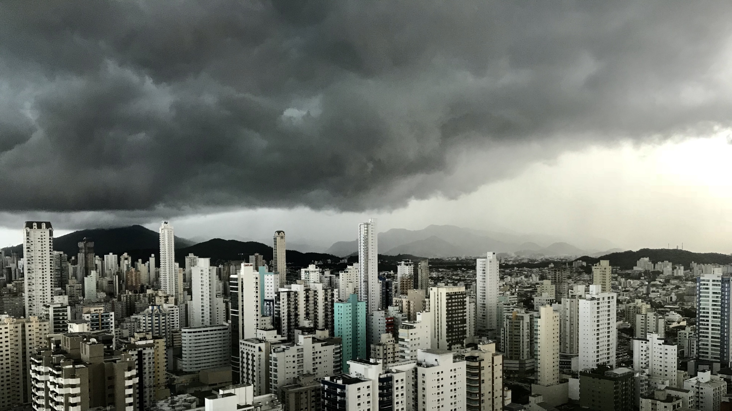
Slide 11
THANK YOU

